Slide 1

System Overview
Model 1122 Abolisher® Reject Gate Control™ Technology
Bruce T. Dobbie
Copyright© R.K.B. OPTO-ELECTRONICS, INC. All rights reserved.

Slide 2

Mission Statement
Splice Detector Technologies is a designer and manufacturer of high speed splice, tearout, missing ply and web break detection equipment and related products. We are committed to the industry and our customers that depend on us to ensure that quality is maintained at the highest possible level. We are dedicated to increasing customer satisfaction, continuously improving our products and services, and providing opportunities for our employees to achieve their maximum potential.

Slide 3
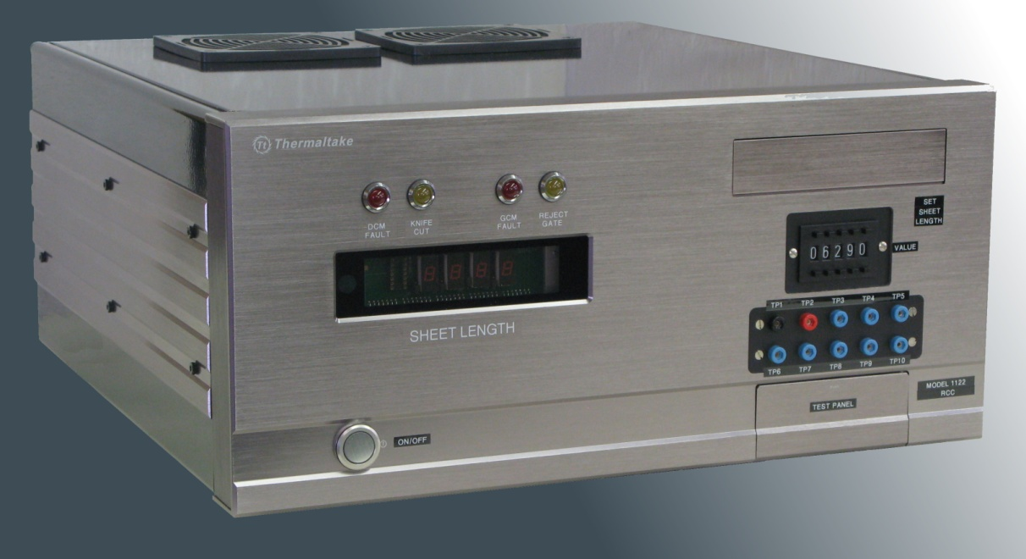
Model 1122 Abolisher® Reject Gate Control™ Technology
FOR MORE INFO...
http://www.splicedetector.net/splicedetector_products/reject_gate_control.html
http://www.splicedetector.com/splicedetector_products/m1122_reject_gate_control.html

Slide 4

Technology

Slide 5
System Overview
The Model 1122 Abolisher® Reject Gate Control™ Technology is intended for fully automating the cutting/sorting application, providing an automatic reject facility for defective sheets. Typically installed between the automatic sorting and inspection system, the reject control computer ensures that the product is inspected, cut or sorted automatically without intervention by operators. This method of operation provides faster and more reliable defect rejecting capability. The 1122 rejects defective sheets regardless of operation speed. In any application, if the defect occurs in such a manner that it is bisected by the knife, the system's accuracy will ensure that both sheets are rejected (assuming margin inhibit is not employed).

Slide 6
System Overview
The model 1122 receives three (3) types of information from the inspection system that is stored in digital memory. First it provides a pulse corresponding to the hole defect when it passes the inspection line. Second, it receives a synchronizing pulse that corresponds to future cut lines (trailing edges), and third, a synchronizing pulse relative to the instant cut and the reject line to determine when to move the deflector safely before the leading edge of the defective sheet approaches the deflector. The model 1122 also can determine how many complete sheets and parts (fraction) of one sheet are between the inspection line and rejection line. The system is capable of memorizing up to 16 sheet lengths from the inspection line to the reject line. As safety, a margin inhibit switch disengages the reject mechanism when a defect falls within 1/4"(6.35 mm) of the cut line, (i,e., within a margin which will be trimmed later).

Slide 7
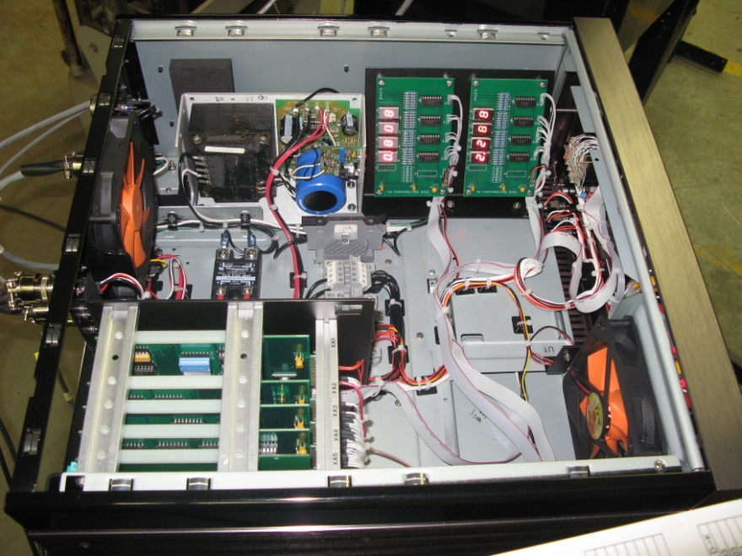
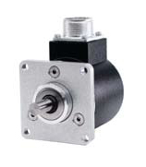
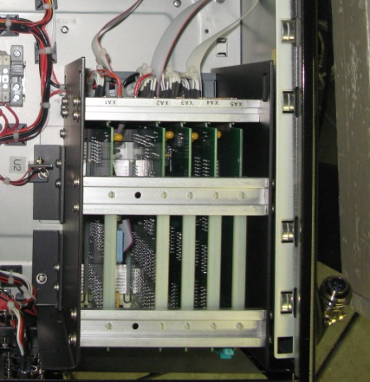
Theory of Operation
The Model 1122 Abolisher® Reject Gate Control™ Technology is comprised of 4 modules and a shaft encoder. The shaft encoder is mechanically linked to the knife of a cutter via direct coupling or a timing belt and timing belt pulley. The signals generated by this shaft encoder are two. One signal is 1 pulse per rotation of the shaft encoder, the other signal is 1000 pulse per rotation of the encoder

Slide 8
Theory of Operation
To set the encoder the 1 pulse per revolution must occur. That is the pulse must be high ‑ 12 volts when the knife is 50% through the cut. This pulse is called the "zero" pulse or "marker" pulse. The other signal is continuous with the rotation of the knife. The 3 modules are called the "DCM" or "Detector Control Module", "GCM" or "Gate Control Module" and the PSM "Power Supply and Gate Control Module". Shaft encoder signals are introduced into the GCM and are conditioned, that is they go to a squaring circuit to make nice, clean, sharp, rise and fall pulses, they are then fed to circuits in both the DCM and GCM. These pulses are used to define "future cut line pulse" in the DCM when a "future cut line" passes the detector. A "leading edge" pulse is generated in the GCM to define when a "leading edge" of a sheet is approaching the "reject gate". If a sheet with a splice on it approaches the "reject gate" it will open and stay open for 1 full sheet length and then close. If there is splices on sequential sheets, the reject gate will stay open until the next clean sheet approaches the reject gate, then it will close again.

Slide 9



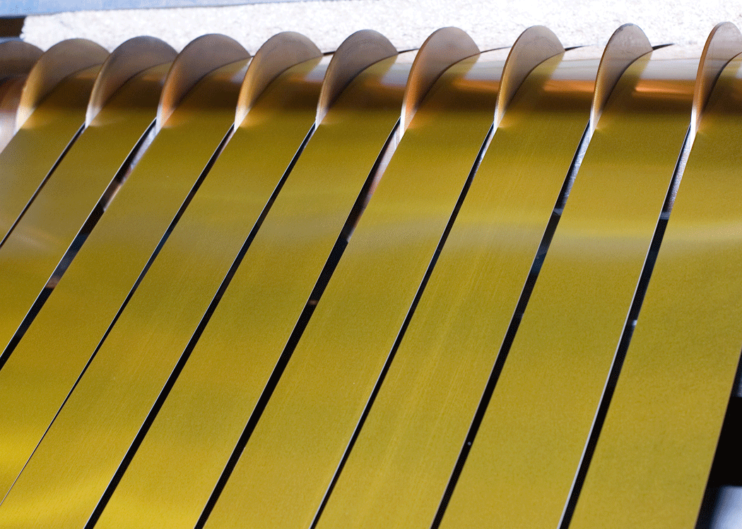
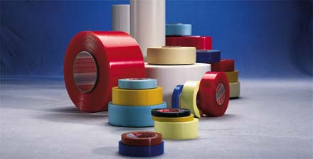



Features and Benefits
Can be utilized with any type of web based material that is being slit, cut and sorted.

Slide 10
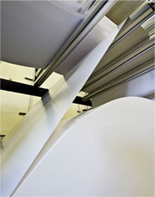
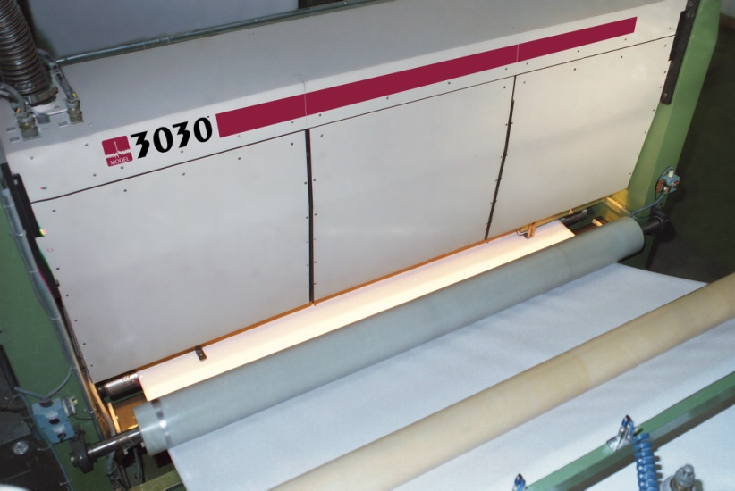
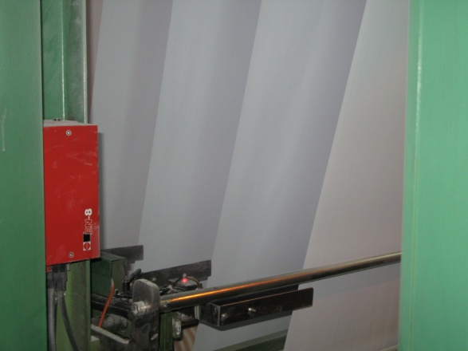
Features and Benefits
Can be interfaced with any inspection system from any company monitoring one or multiple webs. Widely used with SDT splice detectors and FCS-WIS systems.

Slide 11
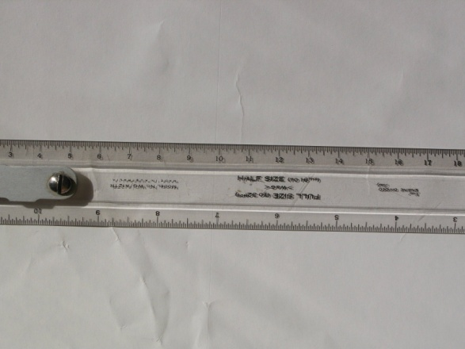



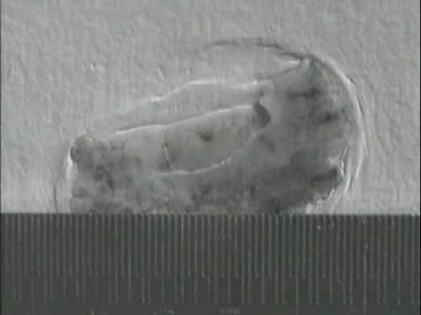
Features and Benefits
Unaffected by material basis weight changes, color, defect types or process speed.

Slide 12






Features and Benefits
Unaffected by printed material.

Slide 13
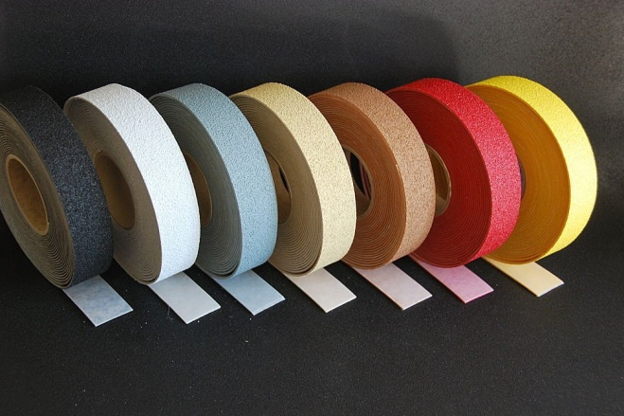
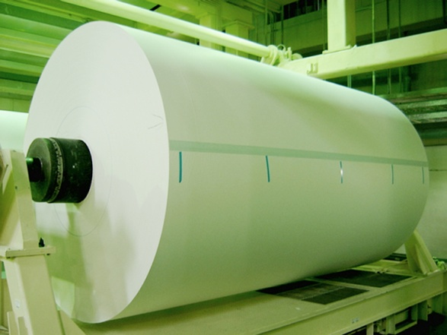
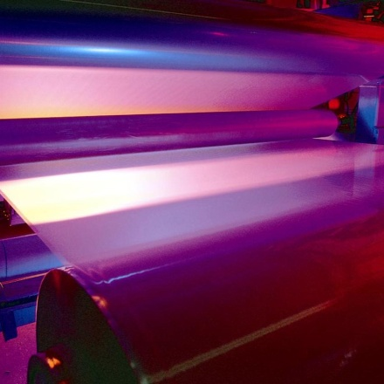
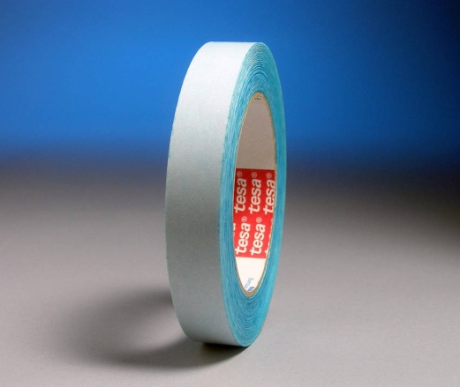
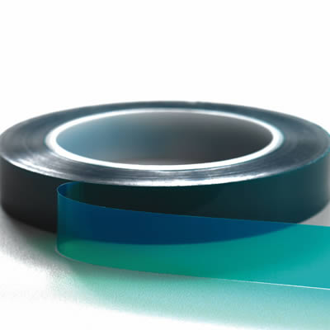
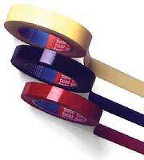
Features and Benefits
Special splice tapes or color marking do not affect detection and rejection.

Slide 14
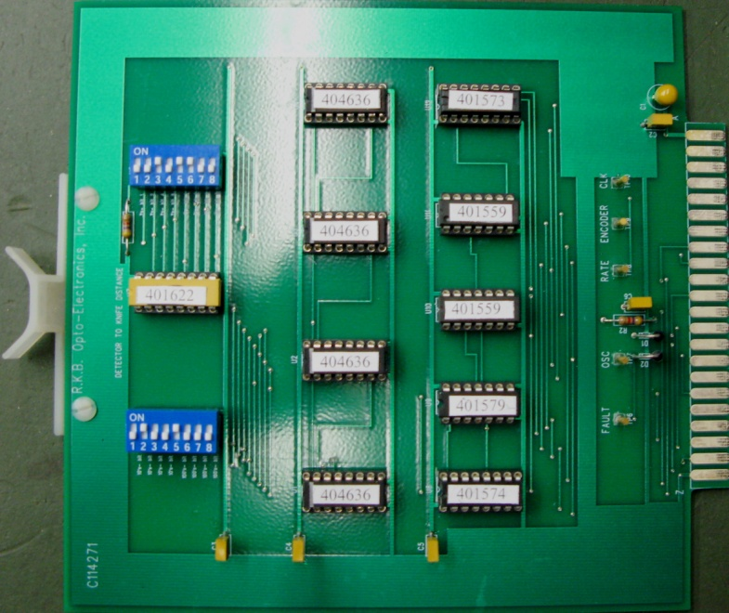
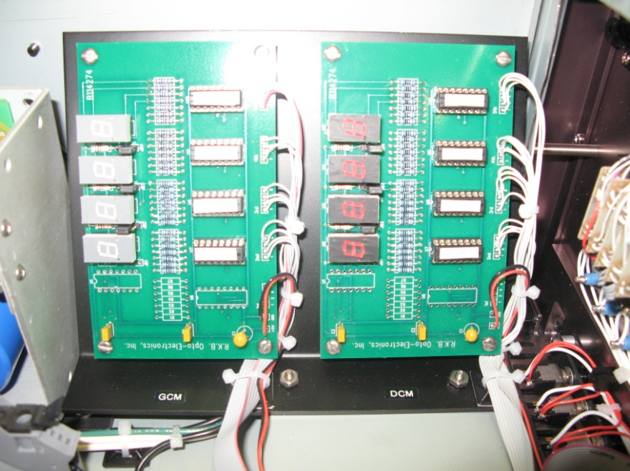
Features and Benefits
The Model 1122 Abolisher® Reject Gate Control™ Technology incorporates state-of-the-art electronic design circuitry, components, filtering and processing techniques unequaled in the industry.

Slide 15
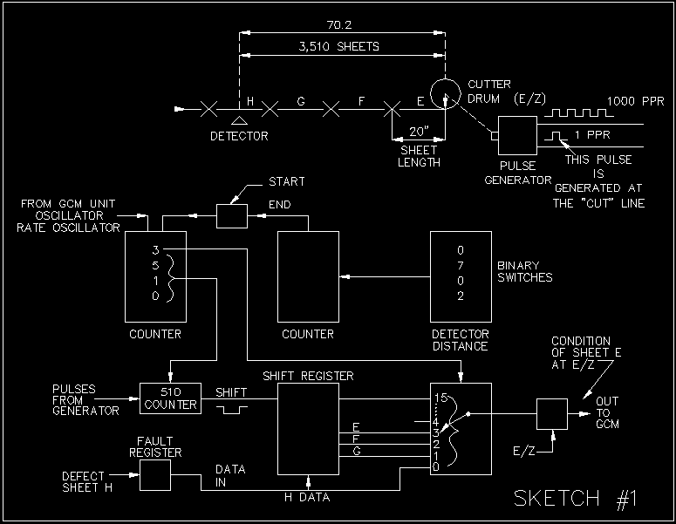
Features and Benefits
State-of-the-Art Proprietary Processing.

Slide 16
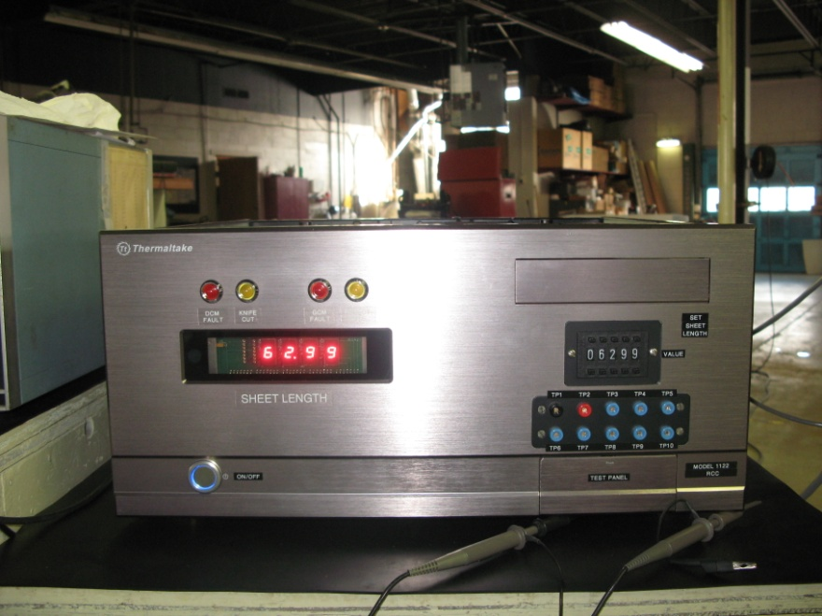
Features and Benefits
Highly visible indicator lamps and optional audio/visual alarms provide immediate alert to operational staff. Provide user friendly outputs you can actually use too process control instrumentation.

Slide 17
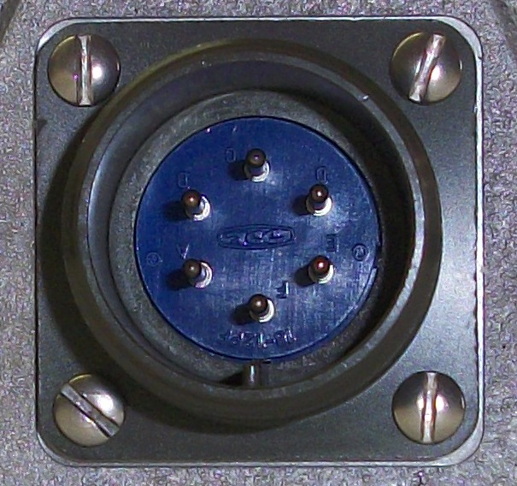
Features and Benefits
Military type connections ensure solid electrical specifications are maintained and environmental protection is achieved.

Slide 18
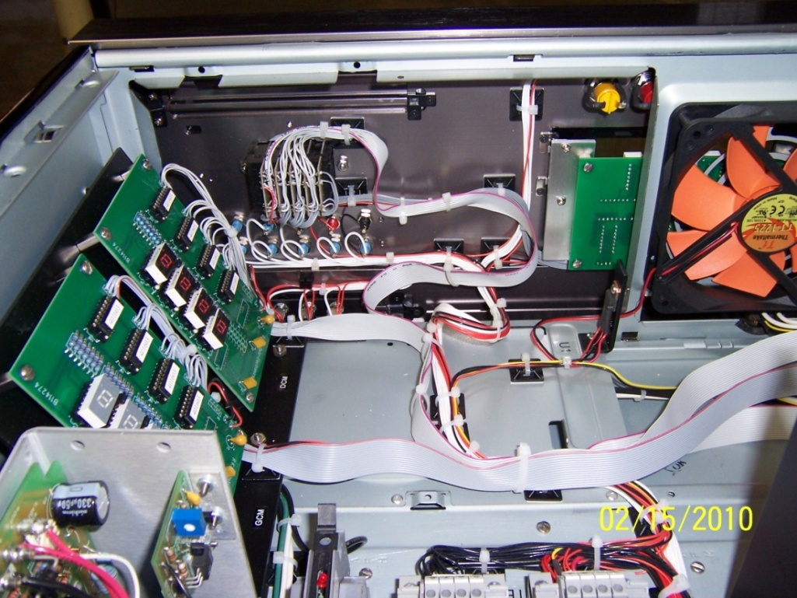
Features and Benefits
Automatic calibration verification of sheet length and reject settings.

Slide 19
Features and Benefits
Meets quality initiative and ISO requirements.
Operation 24/7 without the need for operational intervention.
Eliminate the need for manual rejection of defects.
CE, CCC and RoHS Compliant

Slide 20
Applications
Sheeters
Or any process machine that has rejection capabilities

Slide 21
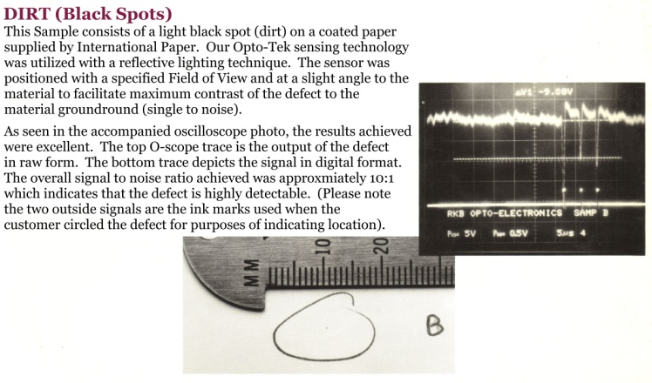
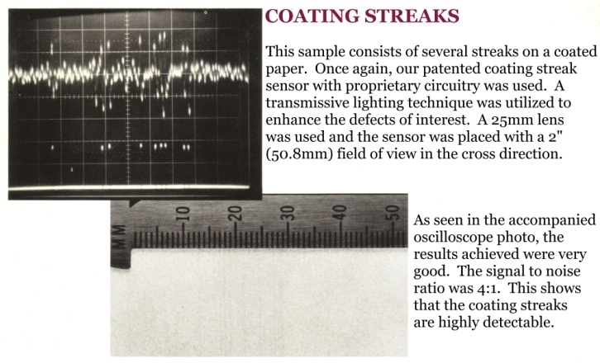
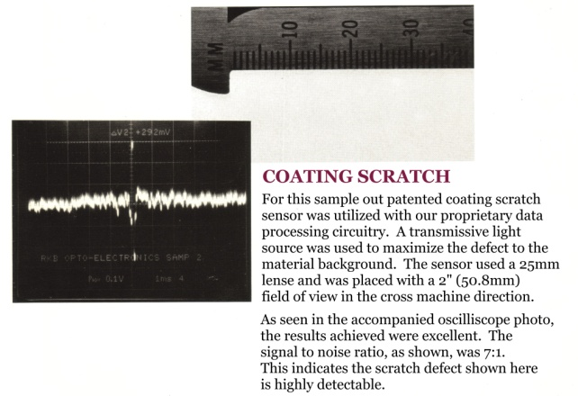
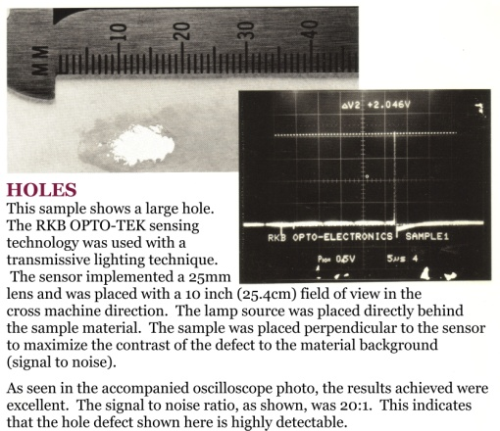

Detection Results
The result is the rejection of any defect or splice type fault.

Slide 22
Power Requirements
Inputs required ‑ 115 VAC, 50‑60 cps, 1 amp
Defect signals ‑ Positive going 12 +/‑ 3 volt pulses
of at least 100 microsecond duration
are required. These may originate
from an detecting equipment such as
the R.K.B. Model 1032 Splice Detector
or other devices.
Pulse Generator ‑ The pulse generator provided with equipment must be installed by the customer such that it is coupled to the knife cutter at a ratio of 1:1 exact.

Slide 23
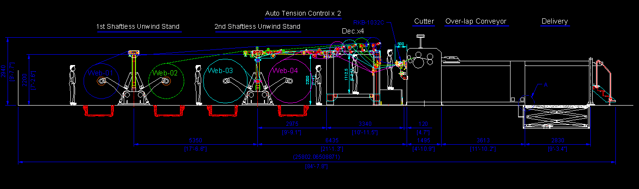
Typical Installation

Slide 24
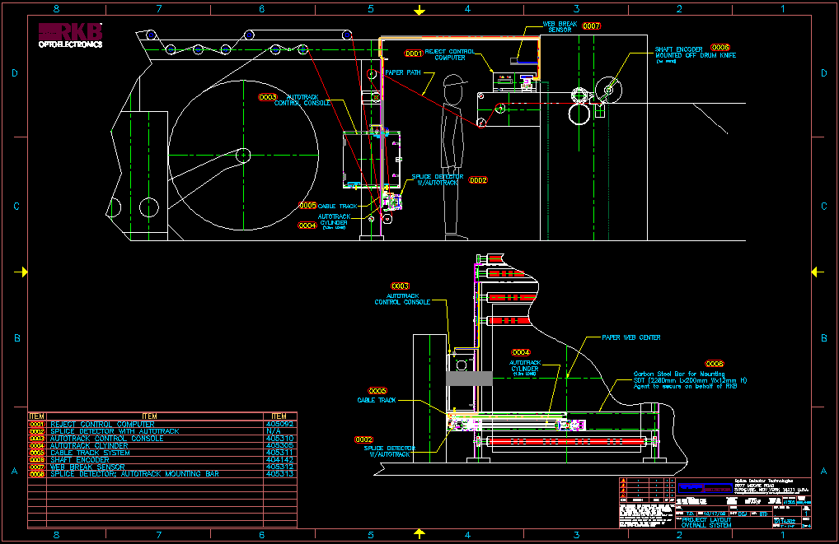
Typical Installation

Slide 25
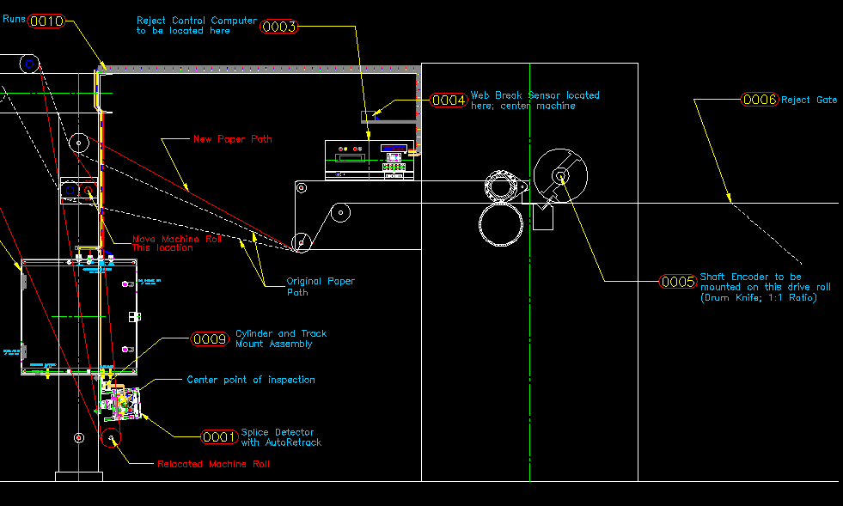
Typical Installation

Slide 26
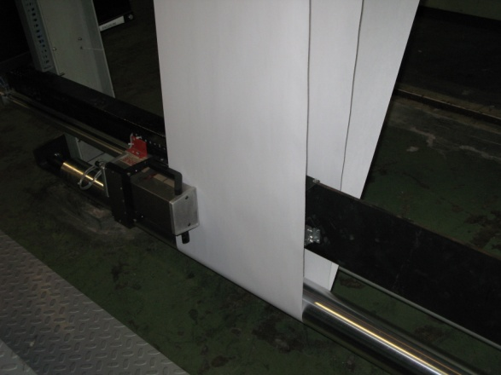
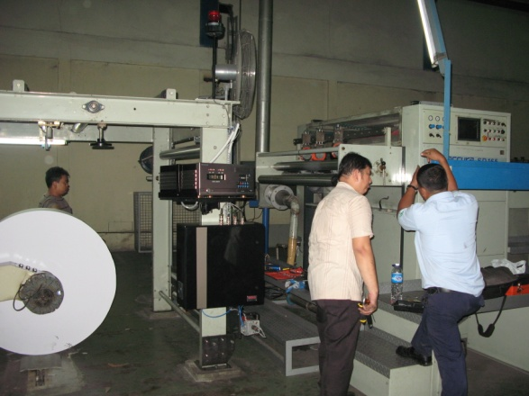
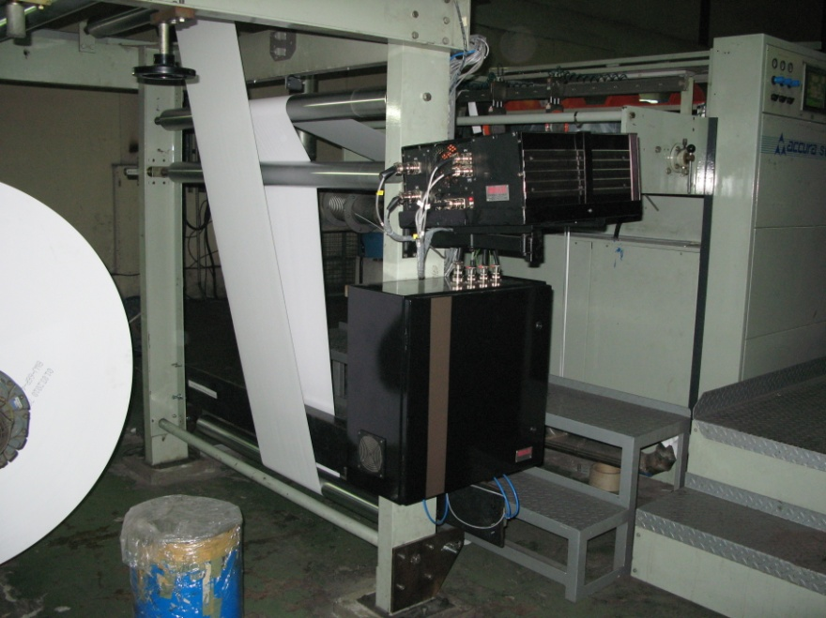
Installation at Major Paper Maker

Slide 27

References
For reliability; large, medium and small companies turn to SDT for their reject control technology needs.

Slide 28
Related Websites
  R.K.B. OPTO-ELECTRONICS, INC., Syracuse, New York, United States
  http://www.rkbopto.com
  R.K.B. Europe, Santander (SPAIN)
  http://rkbdetector.com/
  Arkia Industrial, Sao Paulo, Brasil
  http://www.arkia.com.br
  FIOCCHI Process Instrumentation, Milan, Italy
  http://www. fioproin.it
  Grupo ROSA Automatización y Control S.A. de C.V., Chihuahua, Mexico
  http://gruporosa.com.mx/
  PT. Pentraco Karya Adiprestasi, Jakarta Barat, Indonesia
  http://www.pentraco.com/
  Quality2Process B.V., Hengelo, The Netherlands
  http://www.quality2process.com
  Splice Detector Technologies, Syracuse, New York, United States
  http://www.splicedetector.net / www.hole-detection.com / www.webinspection.us / www.splicedetector.com
  Suzhou Machine Vision Co., Ltd., Suzhou, Jiangsu, China
  http://rkb.chinapaper.net
  Swallow Machinery Co., Ltd., Meltham, Holmfirth, United Kingdom
  http://www.swallowmachinery.com

