Slide 1

System Overview
Model 4000 AutoTrack® Technology
Bruce T. Dobbie

Slide 2

Mission Statement
R.K.B. OPTO-ELECTRONICS, INC. is a designer and manufacturer of high speed machine vision, web inspection, process control and quality assurance and related technologies. We are the most diverse supplier and are committed to the industry and our customers that depend on us to ensure that quality is maintained at the highest possible level. We are dedicated to increasing customer satisfaction, continuously improving our products and services, and providing opportunities for our employees to achieve their maximum potential.

Slide 3
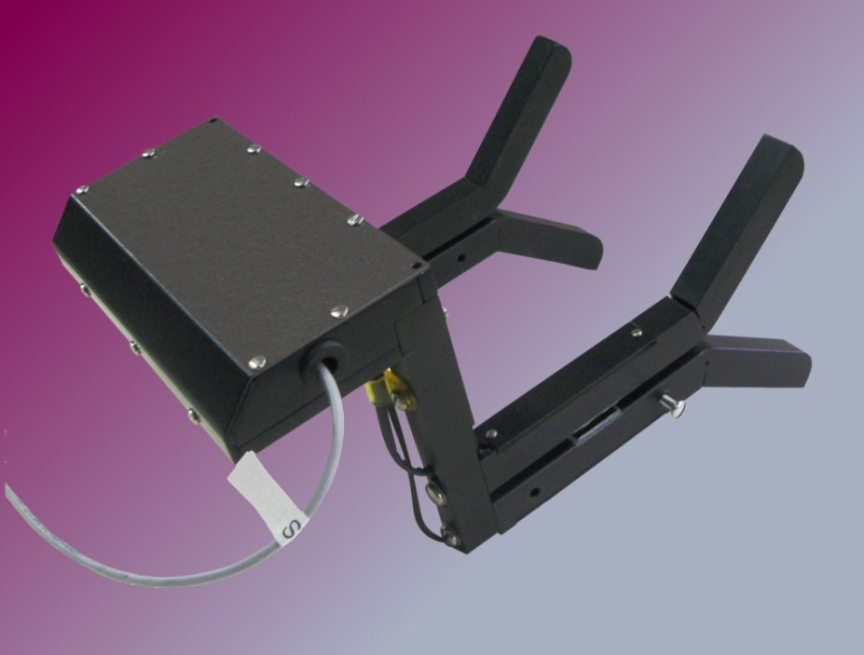
Model 4000 AutoTrack® Technology
FOR MORE INFO...
http://www.rkbopto.com/rkbproducts/4000.html
http://www.splicedetector.net/splicedetector_products/autotrack_control_technology.html
http://www.splicedetector.com/splicedetector_products/m4000_autotrack_control_technology.html

Slide 4

Technology

Slide 5
Overview of Technology
The Model 4000 AutoTrack® Technology is an advanced automatic tracking system designed so our customer can adapt edge mounted quality assurance, control and analytical monitors and/or components to facilitate complete automation. The technology incorporates high tech electronic edge sensors, controls and rodless cylinders which provides the ability to automate any technology to advance/retard into inspection mode eliminating operational intervention and ensuring the quality control components are “ONLINE” 24 hours a day or when needed. This system frees up operational staff to perform their duties relative to production without the need to “REMEMBER” to place sensitive monitoring systems back online upon web threading. The technology can be applied to all equipment made by Splice Detector Technologies and any competitive or non-competitive inspection, sensor or process system supplier.

Slide 6
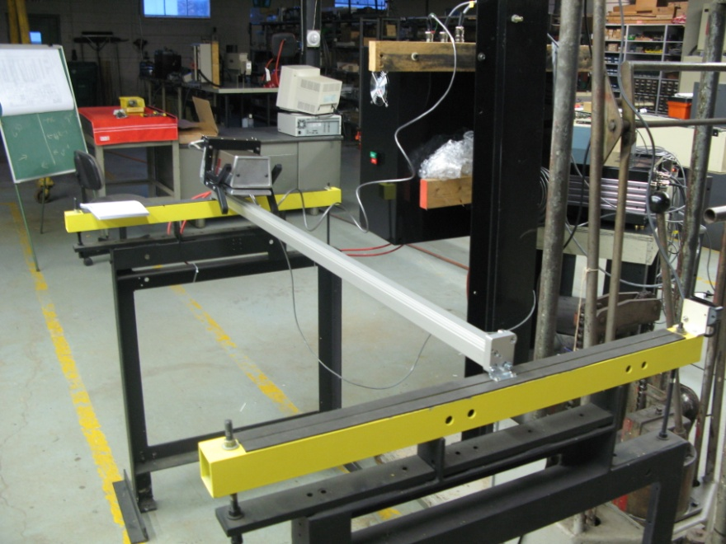
Overview of Technology
Our AutoTrack technology utilizes pneumatic and electric drive technology and proprietary tracking sensors. Compact linear drives with or without guide(s): mechanically coupled cylinders with optimized mounting options for simple mounting and magnetically coupled cylinders for use as a pressure tight and zero leakage system are all considered when it comes time to AutoTrack your machine vision, analytical or inspection device. Low space requirements, high precision and load capacity and reliable service life of up to 40,000km will facilitate just about any application where control automation should be applied. These easy to install and highly reliable cylinders and durable, yet glide with ease to ensure the most sensitive components are handled with care.

Slide 7
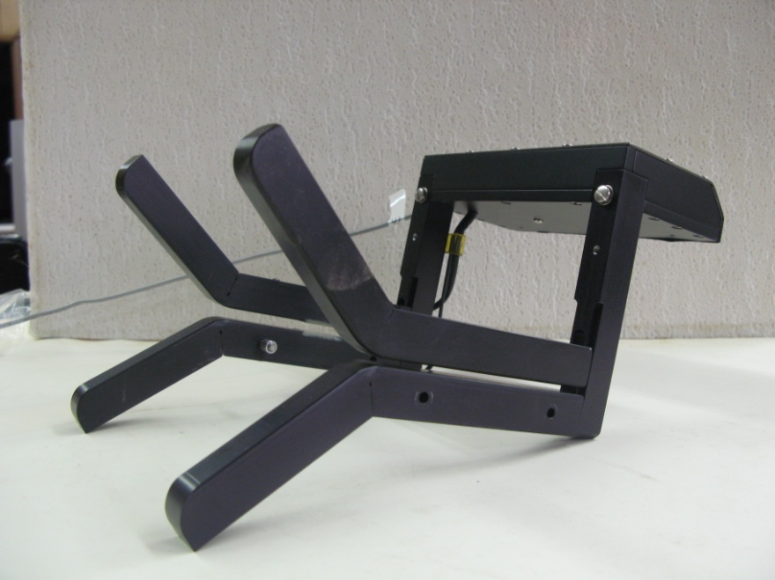
Overview of Technology
The Model 4000 AutoTrack® Technology unique web edge tracking capability is derived from custom sensing arms that provide process functions to advance/retard automatically. The arms, precision machined will not damage sensitive web materials and are made of light weight aluminum. Our web break sensor that provides the “Web On” / “Web Off” signal will facilitate the advancement and retraction of your device. Our unique edge tracking ensure your inspection device will follow the web and will always be located in the sweet spot for reliable detection. What operational staff once had to remember to do prior to production runs is now a moot point. In short, operational intervention is no longer needed to ensure you quality monitoring device is doing its job.

Slide 8
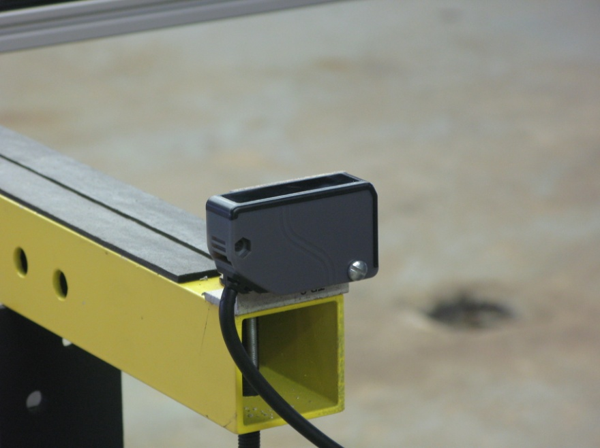
Overview of Technology
The Model 4000 AutoTrack® Technology will respond to changing conditions such as deckle (web width) changes automatically to ensure your inspection devices are always placed in the correct inspection area. By receiving a signal from the center of web mounted web break detector, this technology will always be online unless a web break occurs or scheduled maintenance policies are initiated. No adjustments, settings or re-calibrations are required. Our AutoTrack is unaffected by material types, calipers, process speeds and ambient lighting. Special markings are not required and the operation is unaffected by printed material.

Slide 9

Overview of Technology
Working with designers and manufacturers for more than 50 years to increase manufacturing productivity, Splice Detector Technologies continues to advance the state of industrial automation with proven innovations, customized design solutions, and exceptional service worldwide. Our experienced engineers provide complete support from start to finish, including: conceptualization, analysis, engineering, design, assembly, documentation, validation, and production. Innovation and maximum productivity in industrial and process automation – from single products to the turnkey solutions is the key in today’s competitive web based manufacturing industries. For the success of your business turn to our AutoTrack and take the worry out of non-compliant inspection issues.

Slide 10
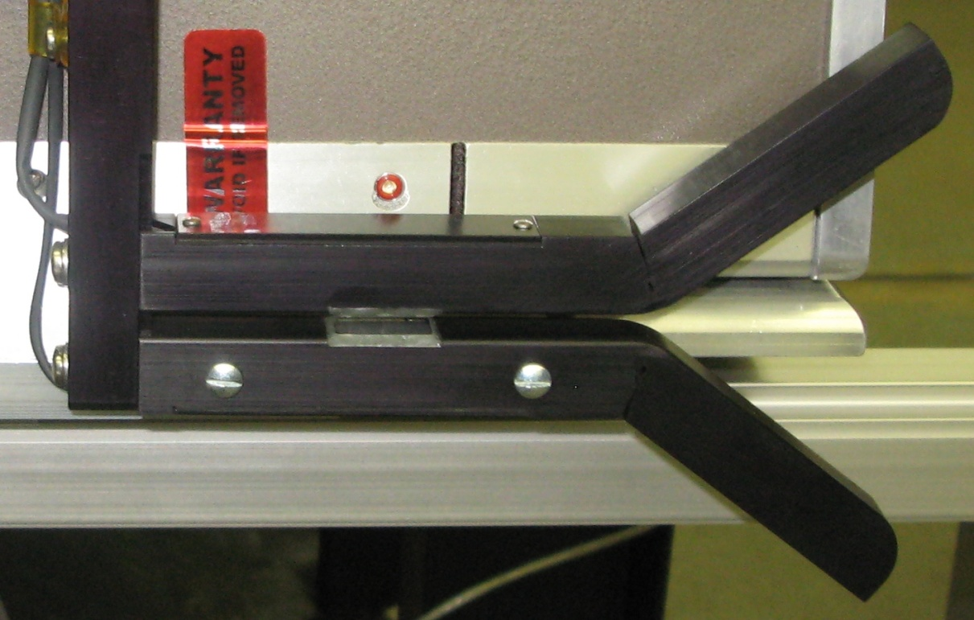
AutoTrack® Features
State of the art Sensing Head utilizing sophisticated photocell technology and digital processing circuitry

Slide 11
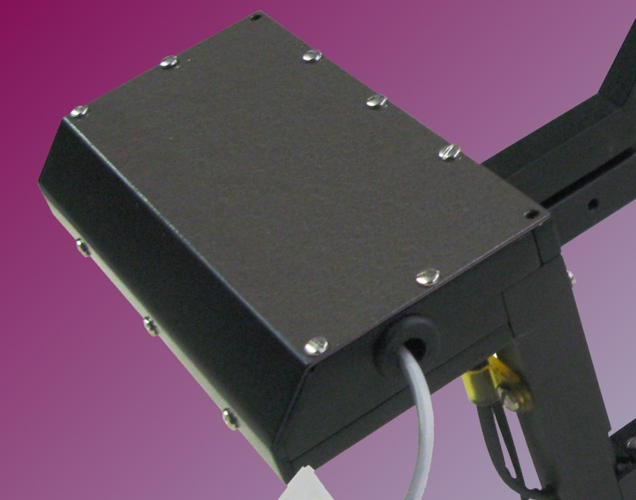
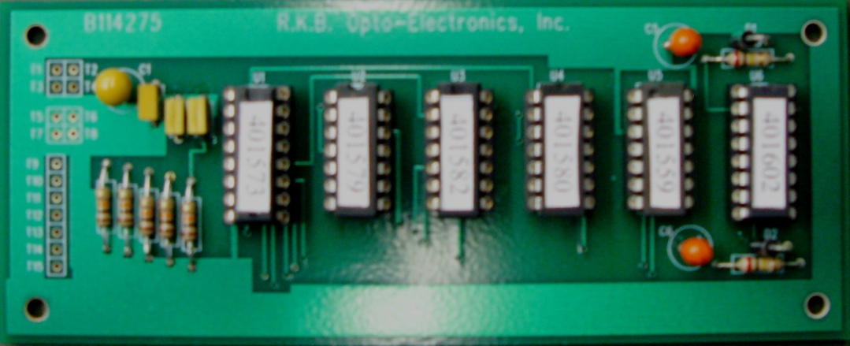
AutoTrack® Features
NEMA Enclosure Housing the sensing circuitry, proprietary filter and Unique Sensitivity auto calibrate functions which ensure 100% uniform inspection of the web.

Slide 12
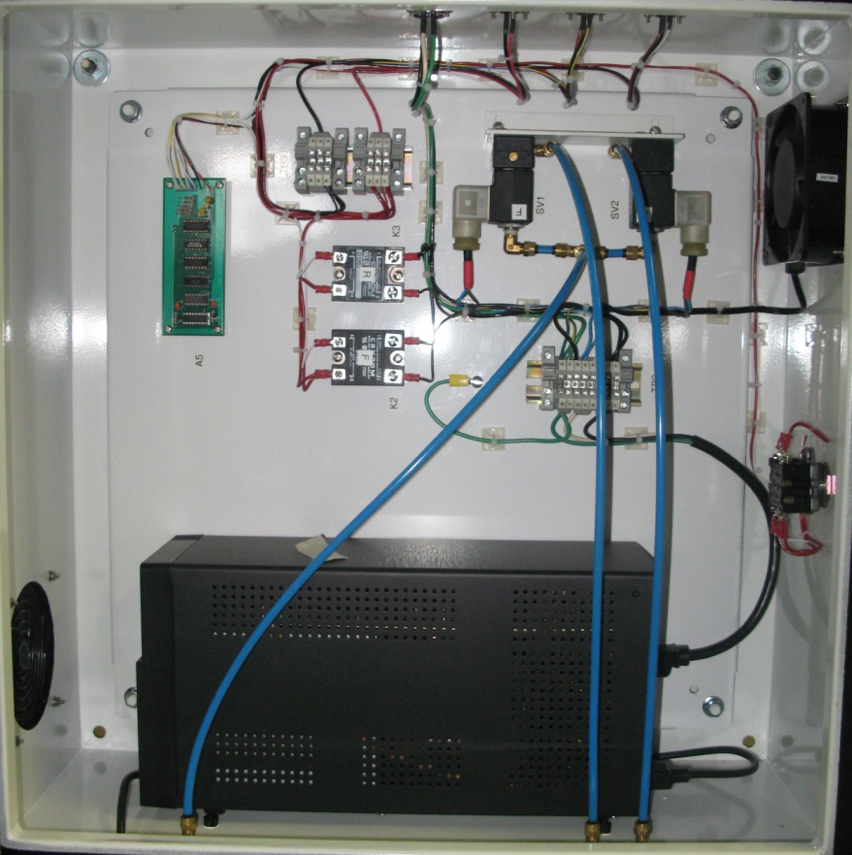
AutoTrack® Features
Integrated Signal Processing Systems housing the engineering workstation where all analog/digital processing is performed. As part of the serviceability of RKB systems, each system comes complete with a dual channel oscilloscope and various testing points to ensure reliable operational and serviceability is maintained.

Slide 13
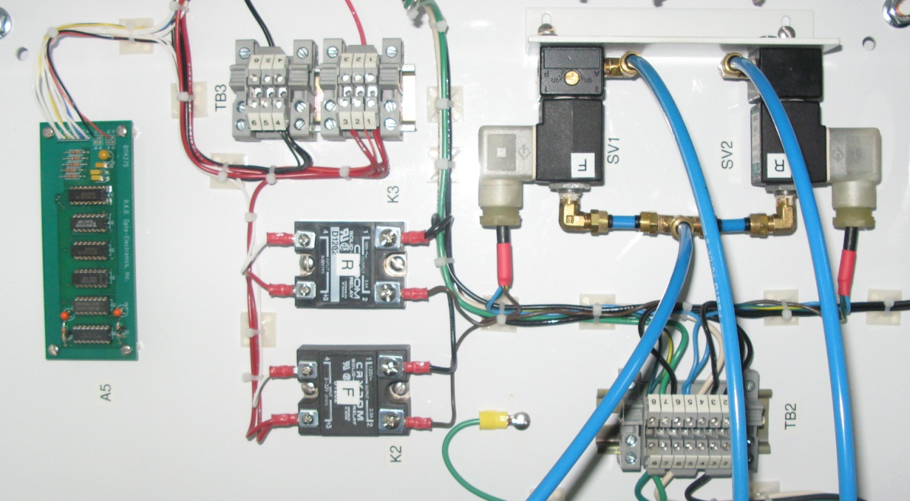
AutoTrack® Features
All processing for electronic signaling and pneumatics located in one NEMA Enclosure to facilitate operation, serviceability and maintenance.

Slide 14
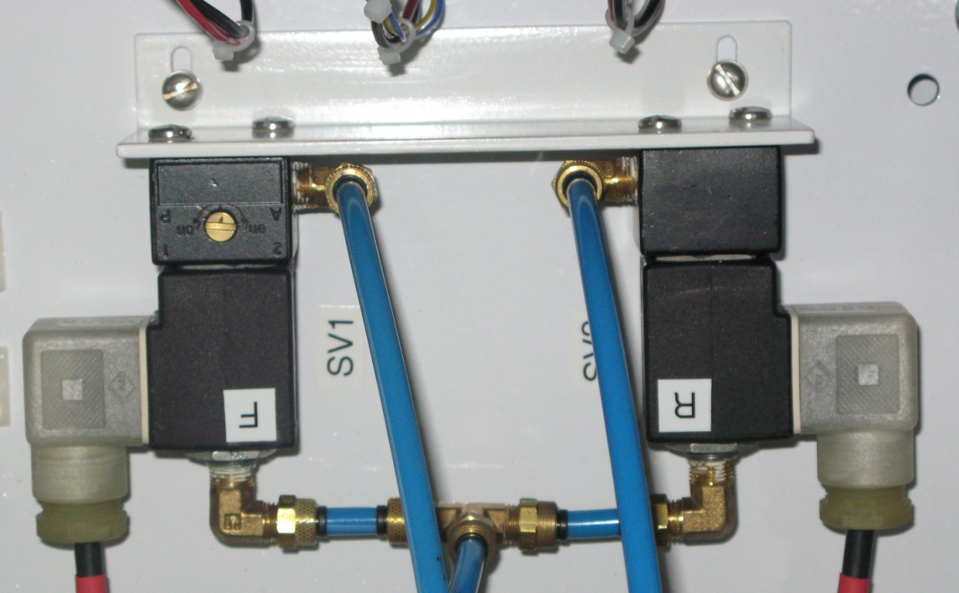
AutoTrack® Features
Forward and Reverse Electronically control Solenoid Valves to facilitate tracking

Slide 15
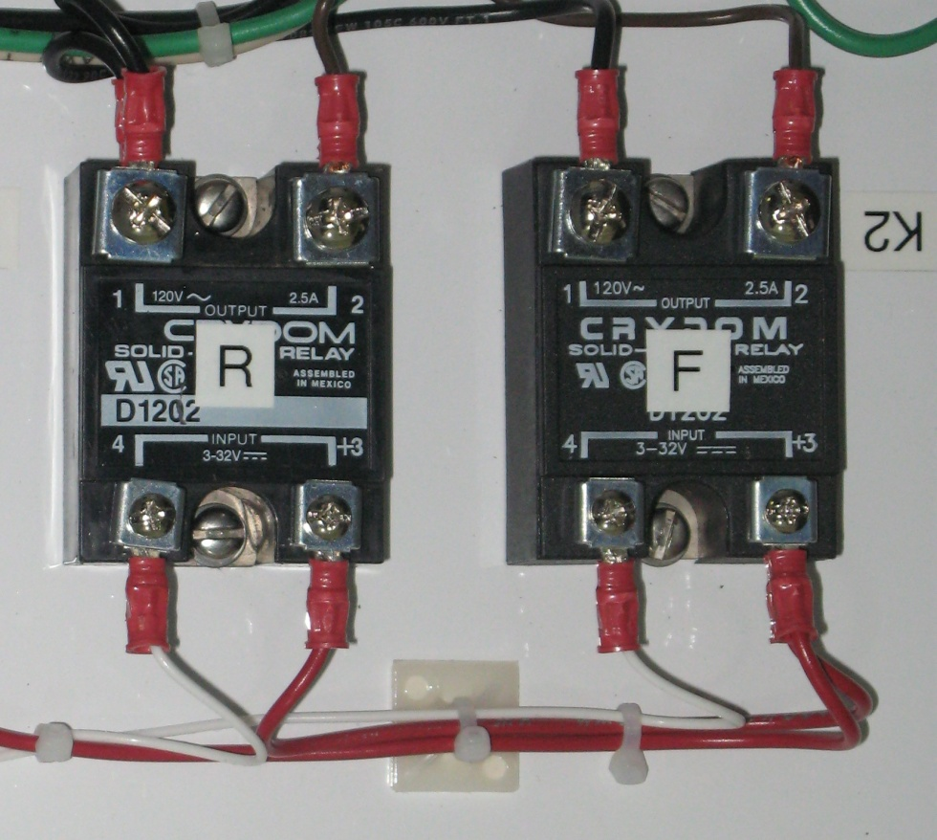
AutoTrack® Features
Forward and Reverse solid state relays

Slide 16
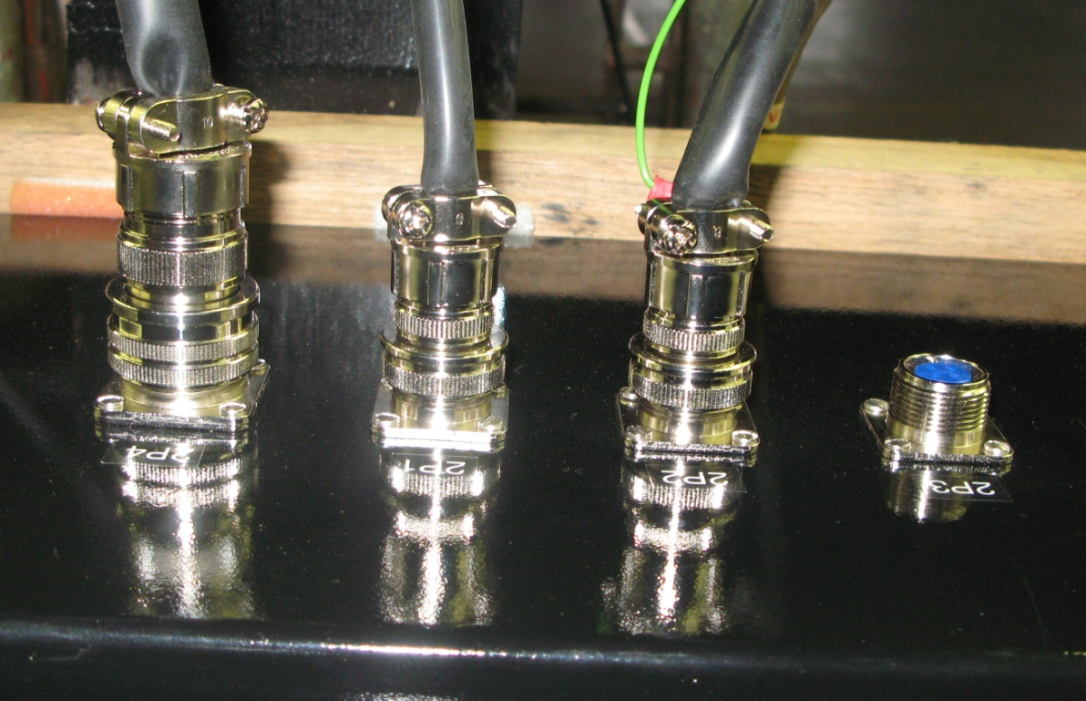
AutoTrack® Features
Military type connections ensure solid electrical specifications are maintained and environmental protection is achieved.

Slide 17
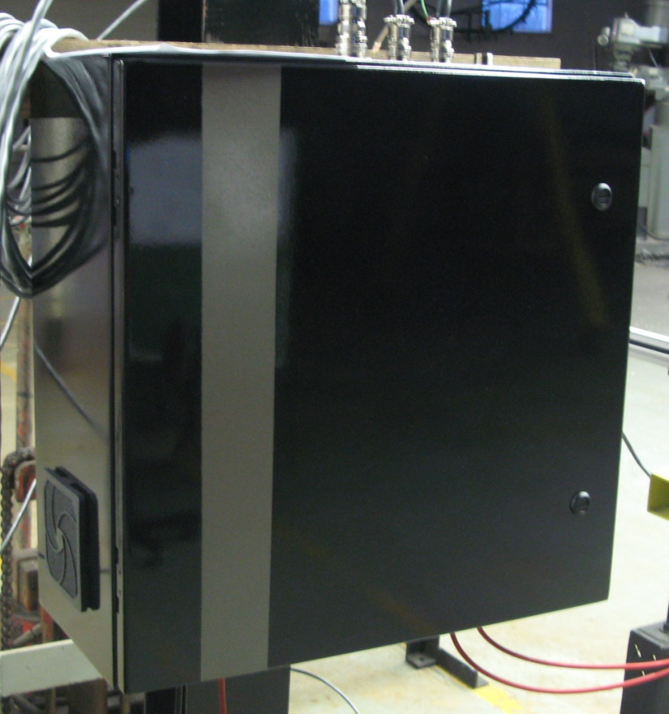
AutoTrack® Features
NEMA Integrated Control Enclosure

Slide 18
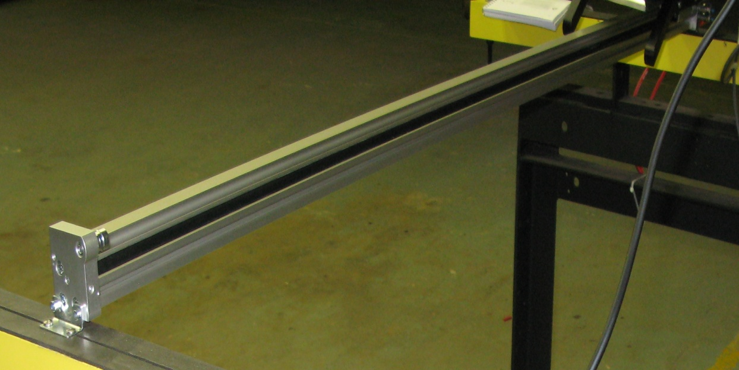
AutoTrack® Features
Pneumatic Linear Cylinder:
10 - 4,000 mm Stroke 25 mm Piston Dia.
PPV: Pneumatic cushioning adjustable at both ends
Heavy-duty guide
positive-locking (slot) drive
double-acting op mode
IP65 Class

Slide 19
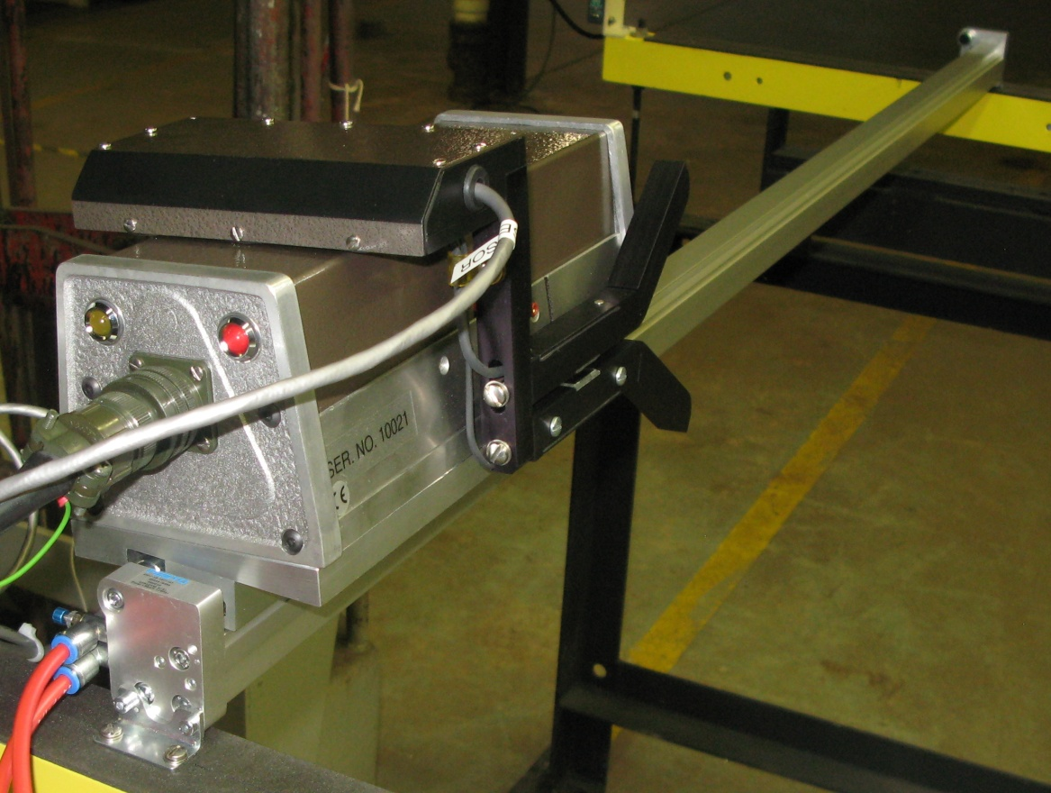
AutoTrack® Features
AutoTrack integrated onto a Sentinel Splice Detector

Slide 20
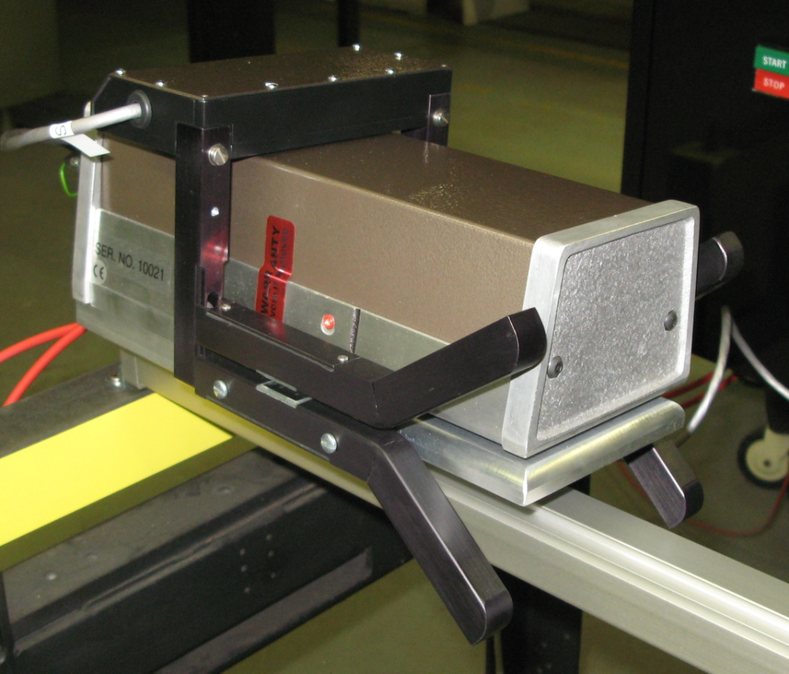
AutoTrack® Features
AutoTrack integrated onto a Sentinel Splice Detector

Slide 21
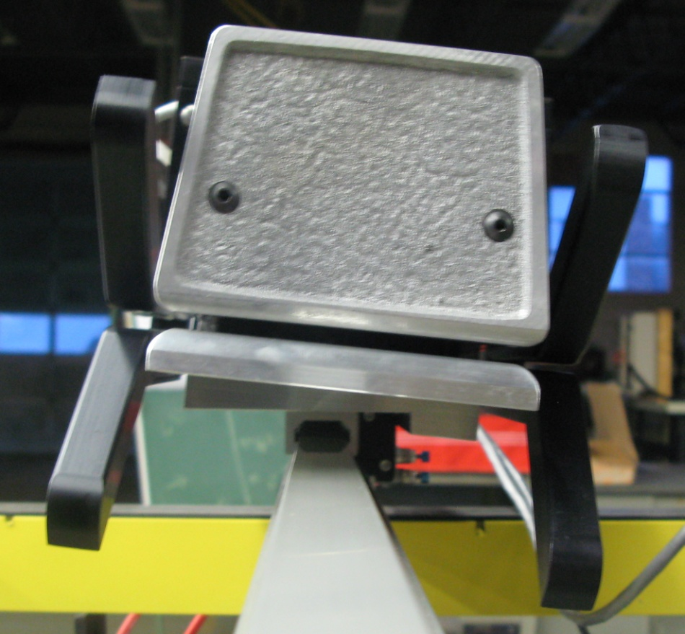
AutoTrack® Features
Precision Machined to ensure 100% continuity to any device which the AutoTrack is applied to.

Slide 22
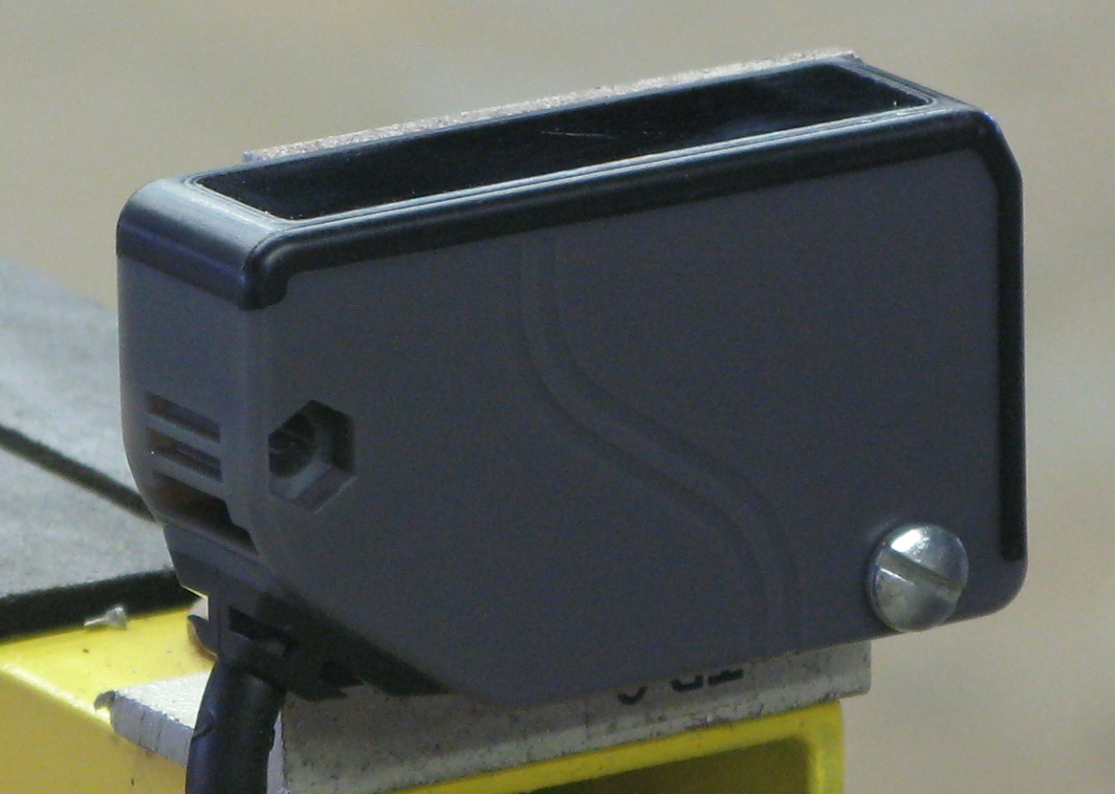
AutoTrack® Features
Proprietary Web Break Sensor Technology to facilitate re-tracking during web breaks.

Slide 23
AutoTrack® Features
State of the Art Power Conditioning and Spike Protection Technology

Slide 24
AutoTrack® Features
Meets quality initiative and ISO requirements.
Detection 24/7 without the need for operational intervention.
Eliminate the need for manual inspections.
CE, CCC and RoHS Compliant

Slide 25
AutoTrack™ Applications
Sheeters
Paper Machines
Roto
Laminators
Slitters
Coaters
Non-wovens

Slide 26
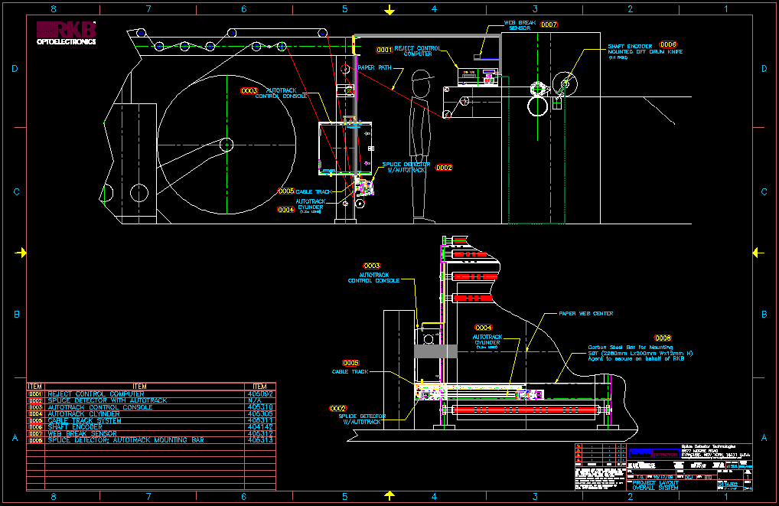
Typical Installation

Slide 27
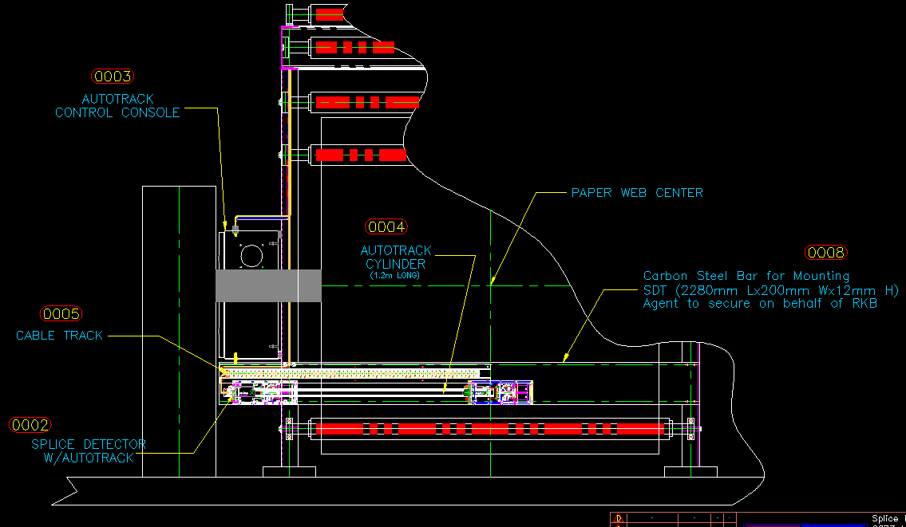
Typical Installation

Slide 28
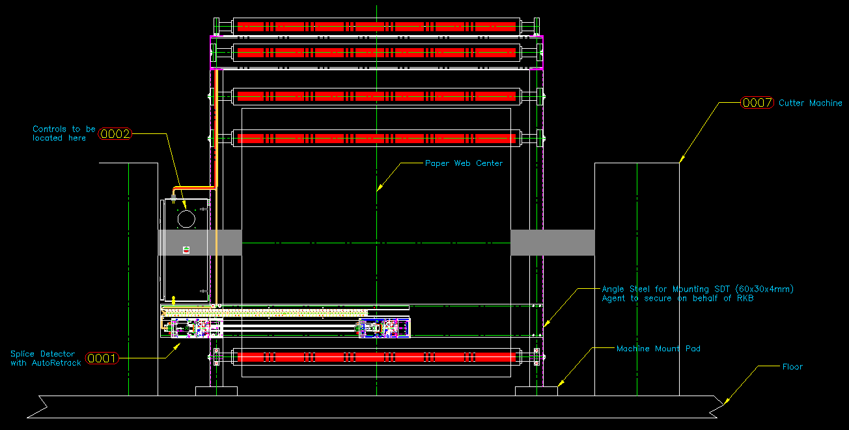
Typical Installation

Slide 29
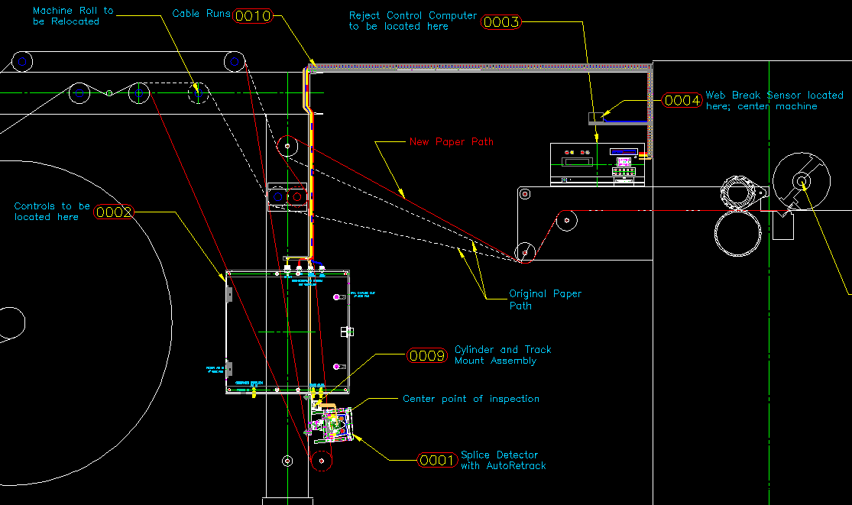
Typical Installation

Slide 30
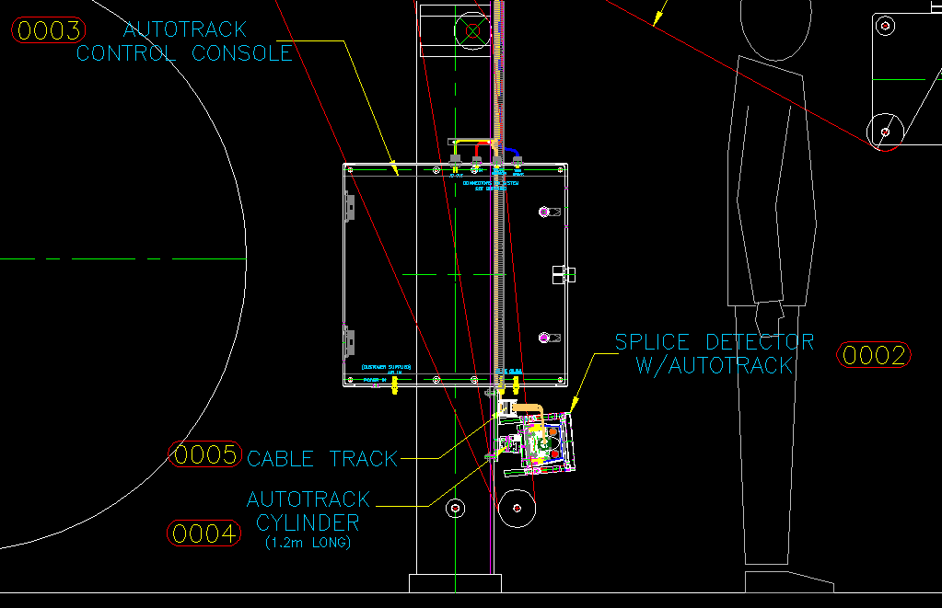
Typical Installation

Slide 31
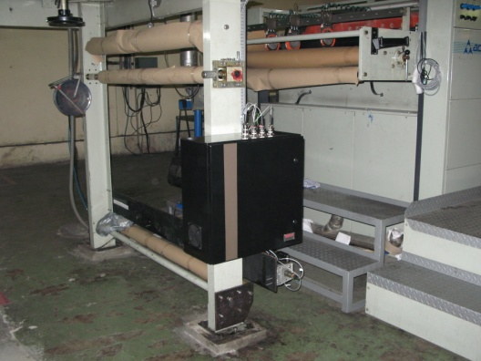
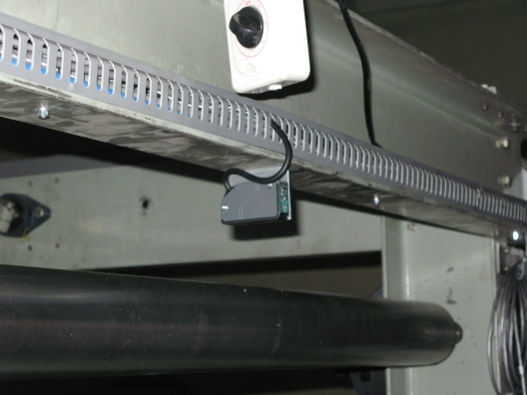
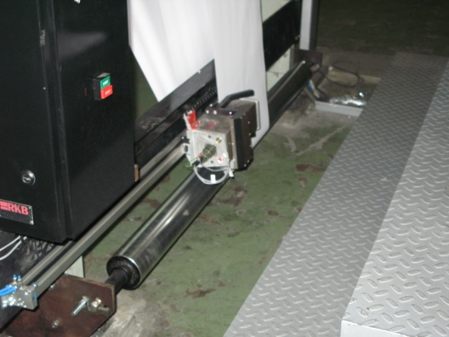
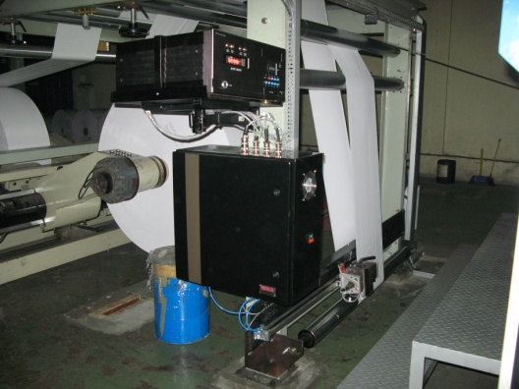
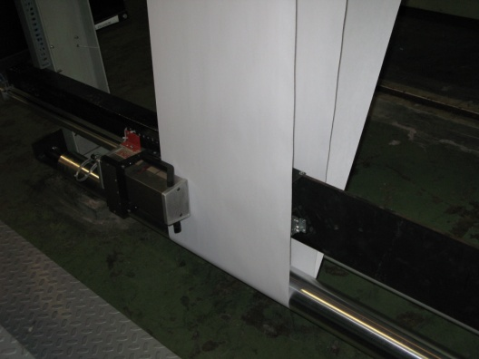
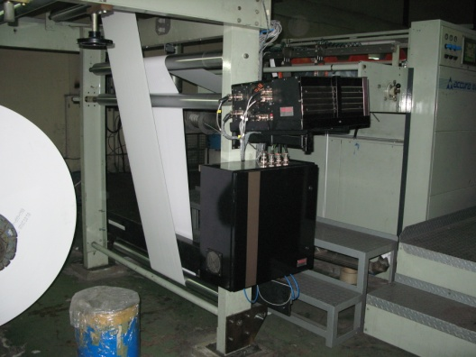
Installations at Major Manufacturers

Slide 32

References
For reliability; large, medium and small companies turn to RKB for their coating streak and scratch defect detection and control needs.

Slide 33
Related Websites
R.K.B. OPTO-ELECTRONICS, INC., Syracuse, New York, United States
http://www.rkbopto.com
R.K.B. Europe, Santander (SPAIN)
http://rkbdetector.com/
Arkia Industrial, Sao Paulo, Brazil
http://www.arkia.com.br
FIOCCHI Process Instrumentation, Milan, Italy
http://www. fioproin.it
Grupo ROSA Automatización y Control S.A. de C.V., Chihuahua, Mexico
http://gruporosa.com.mx/
PT. Pentraco Karya Adiprestasi, Jakarta Barat, Indonesia
http://www.pentraco.com/
Quality2Process B.V., Hengelo, The Netherlands
http://www.quality2process.com
Splice Detector Technologies, Syracuse, New York, United States
http://www.splicedetector.net / www.hole-detection.com / www.webinspection.us / www.splicedetector.com
Suzhou Machine Vision Co., Ltd., Suzhou, Jiangsu, China
http://rkb.chinapaper.net
Swallow Machinery Co., Ltd., Meltham, Holmfirth, United Kingdom
http://www.swallowmachinery.com

